Slide 1
Uncorrelated Unmeasured Driver
Causing Only Additional Error
B. Correlated Driver Causing Omitted Variable Bias
U
U
e
X
Y
e
X
Y
Figure 1: A response variable of interest (Y) is driven by both a measured variable (X) and an unmeasured variable (U) as well as other uncorrelated sources of residual variability (e). In one scenario, X and U are uncorrelated, and thus the lack of inclusion of U in a statistical model increases the standard error of the estimate of the effect of X on Y, but does not alter the causal identification of the statistical model. If U drives X, however (or if U and X are driven by a common unmeasured driver), the omission of U from a statistical model causes bias in the estimate of X on Y in a direction that depends on the effect of U on Y. The results of the model are no longer causally identified.

Slide 2
A.
B.
U
W
U
X
Y
e
X
Y
e
C.
U
D.
W
W
U
Q
X
Y
e
R
e
X
Y
Figure 2: Examples of satisfying the back-door criterion with control variables. By including shaded observed variables, either U or W, in a statistical analysis of the effects of X on Y, omitted variable bias is controlled for the results have a causal interpretation. The relationship between the control variable and Y might (A and B) or might (C and D) not have a causal interpretation, depending on the structure of the system. Note, in (D), Q would have also served as an adequate control instead of W. R would have been a bad control.
Notes:
There are many ways to “shut the back door” depending on how a confounder influences both a causal variable of interest and its response. In the simple case (Fig. 2A with X as the causal variable of interest and Y as the response), a confounder directly influences both cause and effect. The influence of a confounder on either cause or effect can be indirect (Figs. 2B-C), however. In such cases, one can either use the confounder as a control or other variables involved in the open back door (variable W in Figs. 2B-C). A path from W to Y in the resulting statistical models can even have no direct causal meaning (e.g., Fig 2D), although it would provide the proper control enabling us to estimate the causal relationship between X and Y. While this might seem odd, unless you are specifically interested in the relationship between that control variable and the response, it is not concerning; you must be aware of this fact when discussing your results, however.

Slide 3
Recruitment
e
Oceanography
Snails
Local Temperature
Variation
Temperature
Figure 3: A system describing the controls of snail abundance in the intertidal. Oceanography regulates both temperature and recruitment, both of which drive snail abundance. Temperature, however, is also driven by local influences as well. This could be variability in plot-level temperature within a site or site-level temperature variability between years uncorrelated with local oceanography and recruitment.

Slide 4
A) Cross-Sectional Design
(plots nested in sites)
B) Longitudinal/Panel Design
(sites sampled over time)
Site 1
Site 2
Site 3
Time 1
Time 2
Time 3
Figure 4: Visual examples of clustered/nested/hierarchical study designs with n = 3 per site. In these studies, sites are distributed along a coastline with a corresponding thermal gradient. However, they leverage spatial or temporal clusters to take advantage of temperature variation within sites in a cross-sectional study design (A) or temperature variation across time for a longitudinal (a.k.a. panel) design. Open squares are sites. Closed squares are plots within sites. Size of square is proportional to temperature.

Slide 5
A. Path Diagram of a Mixed Model with Site Random Intercept
Site
e
Temperature
Snails
B. Path Diagram of Actual System Highlighting What is Not Controlled For
Site
e
Non-Site Temperature Drivers
Temperature
Snails
Figure 5: The system assumed underlying a mixed model (A) versus the system as it is (B). Note that a mixed model does not account for the correlation between site and temperature nor does it separate out the non-site drivers of temperature. Instead, the effect of temperature on snails is confounded by any correlated site-level drivers that correlate with temperature at the site level.

Slide 6
A. Fixed Effects Transformation Path Model
B. Fixed Effects with a Site Dummy Variable Path Model
e
e
Site
Snails
Deviation from Site Mean Temperature
Deviation from Site Mean Snail Abundance
Temperature
C. Group Mean Covariate Path Model
D. Group Mean Centered Path Model
Site
Site
e
e
Site Mean Temperature
Site Mean Temperature
Snails
Snails
0
Deviation from Site Mean Temperature
Temperature
Figure 6: Path model representations of different statistical models handling spatial omitted variables in the text.

Slide 7
A. System with Temporal Omitted Variable
Recruitment
e
Oceanography
Snails
Local Temperature
Variation
Temperature
Time
Local Coastal Development
B. First Difference Path Model
C. Second Difference Path Model
e
e
Change in Temperature
Change in Snail Abundance
Acceleration of Change in Temperature
Acceleration of Change in Snail Abundance
Rate of Other Site-Level Changes
Figure 7: Path model representations of different models handling spatial and temporal omitted variables.

Slide 8
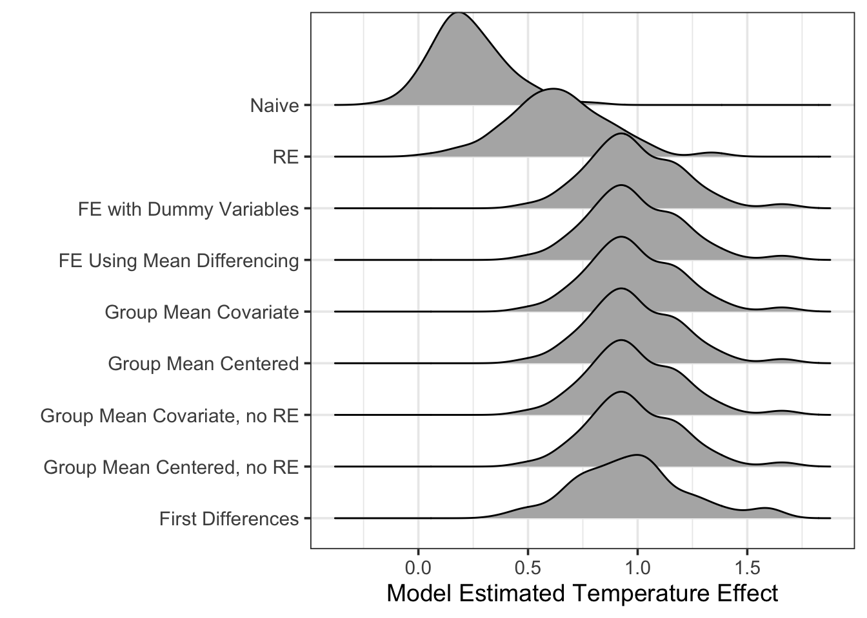
Figure 8: Distribution of point estimates of temperature effects from different models.

Slide 9
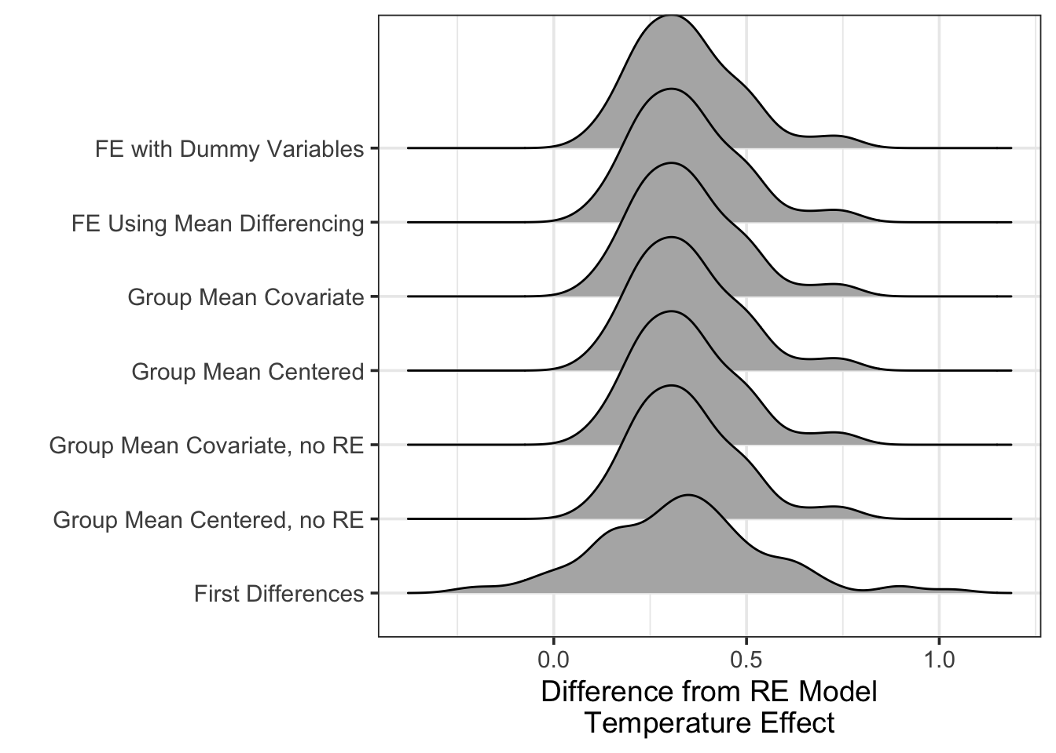
Figure 9: Distribution of difference between point estimate of temperature effect in the RE model versus all other models demonstrating clear bias in the estimand of the RE model.

Slide 10
Table 1: Summary results of simulations. Mean and SD of point estimates of temperature effects from different models in the first two columns. Fraction of simulated runs where the mean +/- 2 SE of the temperature effect either overlapped 0 (i.e., high likelihood of committing a type II error) or did not contain the true effect of temperature in the final columns.
Model Type | Mean Estimate | SD Estimate | Fraction Sims where 95% CI Contains 0 | Fraction Sims where 95% CI does Not Contain 1
Naive | 0.231 | 0.165 | 0.56 | 0.99
RE | 0.640 | 0.232 | 0.08 | 0.54
FE Using Mean Differencing | 0.985 | 0.215 | 0.00 | 0.05
FE with Dummy Variables | 0.985 | 0.215 | 0.00 | 0.05
Group Mean Covariate | 0.985 | 0.215 | 0.00 | 0.05
Group Mean Centered | 0.985 | 0.215 | 0.00 | 0.05
Group Mean Covariate, no RE | 0.985 | 0.215 | 0.01 | 0.04
Group Mean Centered, no RE | 0.985 | 0.215 | 0.01 | 0.04
First Differences | 0.971 | 0.259 | 0.01 | 0.12

